Slide 1

FaZe Clan : Visit and Vote Your Player
Group 1st
Anugrah Perdana
Arfandra Rezky
Bunga Kulsum Veriena
Class : 2SC1
Faculty : Emma Yulianti, ST, MM.

Slide 2
SYSTEM ANALYS
System Summary : This website contained the information as a organization e-sport and contributes to vote the best players of FaZe Clan.
System Process : This website is created to knowing the informations of FaZe Clan, such as social media, team member at each game, memories of winning match, the schedule of match will be held, and contact to connect or send message to the team.
This organization improve a lot because of being winner at many match around the world. For appreciation the player, FaZe Clan makes a voting system to choose the best player that involving the fans.

Slide 3

Before Login
User
Get the information about Faze Clan
See team’s schedule match
See gallery

Slide 4

After Login
User
Get the information about Faze Clan
See team’s schedule match
See gallery
Send Message
Vote for the best player

Slide 5
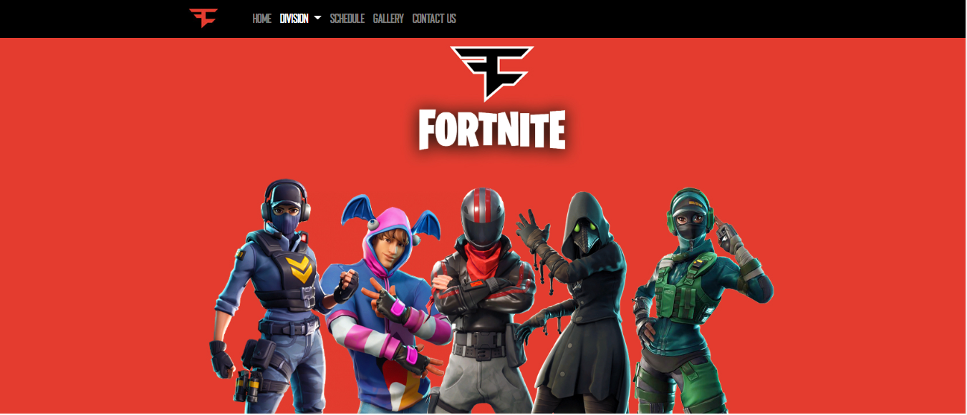



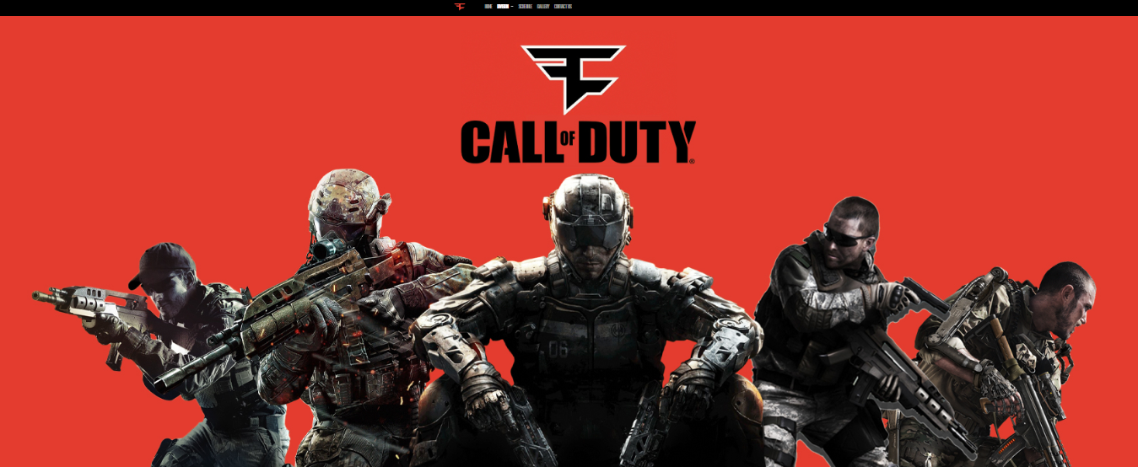

Division

Slide 6
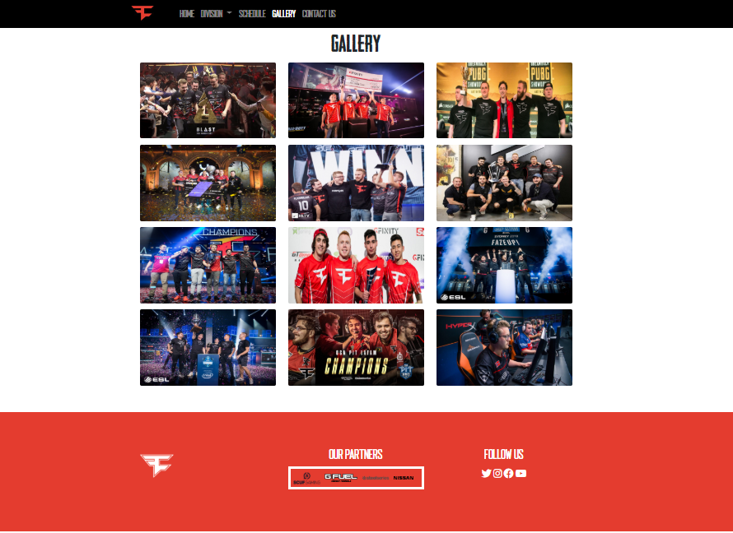
Gallery
Documentary of tournament that FaZe Clan’s division competes at around the world

Slide 7
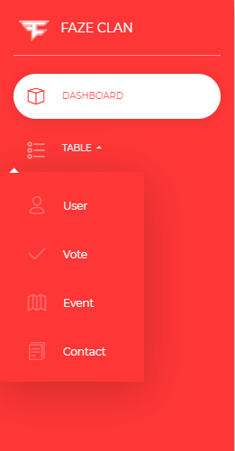
Admin
Edit Vote
See message data
Add event

Slide 8
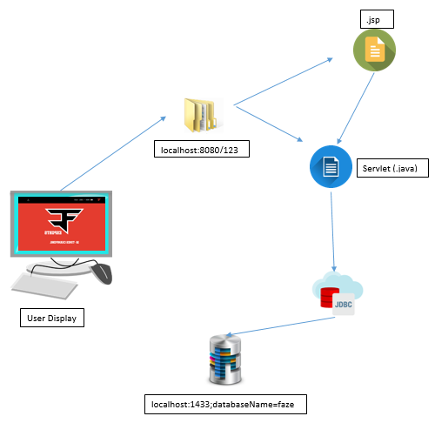
TECHNOLOGY DIAGRAM

Slide 9

Thanks For The Attention

